Slide 1
Structure Programming
ICT-1105
Information and Communication Technology
Lecture-17
Date:

Slide 2
Class contents has given in Google Classroom with code
nhauiw4

Slide 3
Pointers

Slide 4
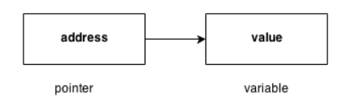
Pointers
Pointer is a variable that stores/hold address of another variable of same data type.
It is also known as locator or indicator that points to an address of a value. A pointer is a derived data type in C.

Slide 5
Pointers
Benefit of using pointers
Pointers are more efficient in handling Array and Structure.
Pointer allows references to function and thereby helps in passing of function as arguments to other function.
It reduces length and the program execution time.
It allows C to support dynamic memory management.

Slide 6
Pointers
Declaration of Pointer
data_type* pointer_variable_name;
int* p;
The unary operator * is the indirection or dereferencing operator; when applied to a pointer, it accesses the object the pointer points to.

Slide 7
Initialization of Pointer variable
Pointer Initialization is the process of assigning address of a variable to pointer variable.
Pointer variable contains address of variable of same data type
int a = 10 ;
int *ptr ; //pointer declaration
ptr = &a ; //pointer initialization
or,
nt *ptr = &a ; //initialization and declaration together

Slide 8
Initialization of Pointer variable
Note:Pointer variable always points to same type of data.
float a;
int *ptr;
ptr = &a; //ERROR, type mismatch

Slide 9
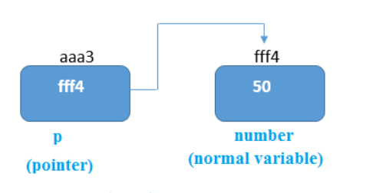
Pointer example
As you can see in the above figure, pointer variable stores the address of number variable i.e. fff4. The value of number variable is 50. But the address of pointer variable p is aaa3.
By the help of * (indirection operator), we can print the value of pointer variable p.

Slide 10
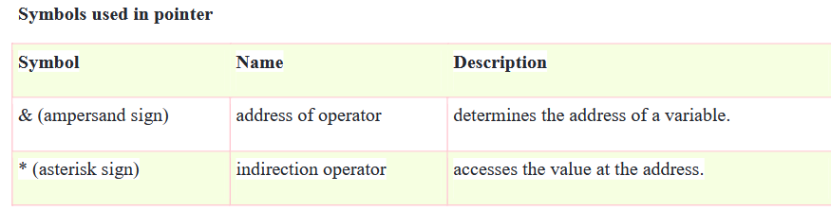
Reference operator (&) and Dereference operator (*)
& is called reference operator. It gives you the address of a variable. There is another operator that gets you the value from the address, it is called a dereference operator (*).

Slide 11
Dereferencing of Pointer
Once a pointer has been assigned the address of a variable. To access the value of variable, pointer is dereferenced, using the indirection operator *.
int a,*p;
a = 10;
p = &a;
printf("%d",*p); //this will print the value of a.
printf("%d",*&a); //this will also print the value of a.
printf("%u",&a); //this will print the address of a.
printf("%u",p); //this will also print the address of a.
printf("%u",&p); //this will also print the address of p

Slide 12
KEY POINTS TO REMEMBER ABOUT POINTERS IN C:
Normal variable stores the value whereas pointer variable stores the address of the variable.
The content of the C pointer always be a whole number i.e. address.
Always C pointer is initialized to null, i.e. int *p = null.
The value of null pointer is 0.
& symbol is used to get the address of the variable.

Slide 13
KEY POINTS TO REMEMBER ABOUT POINTERS IN C:
* symbol is used to get the value of the variable that the pointer is pointing to.
If a pointer in C is assigned to NULL, it means it is pointing to nothing.
Two pointers can be subtracted to know how many elements are available between these two pointers.
But, Pointer addition, multiplication, division are not allowed.
The size of any pointer is 2 byte (for 16 bit compiler).

Slide 14
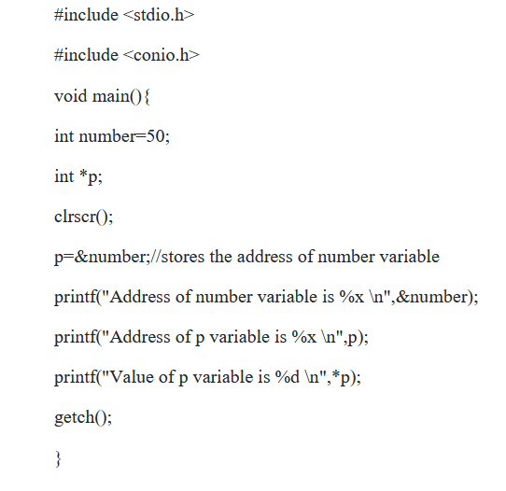
Example-1

Slide 15
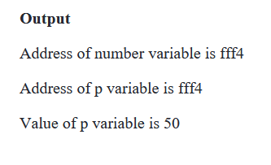
Example-1

Slide 16
Example-2
#include <stdio.h>
int main()
{
int *ptr, q;
q = 50;
/* address of q is assigned to ptr */
ptr = &q;
/* display q's value using ptr variable */
printf("%d", *ptr);
return 0;
}

Slide 17
Example-3
#include <stdio.h>
int main()
{
int var =10;
int *p;
p= &var;
printf ( "\n Address of var is: %u", &var);
printf ( "\n Address of var is: %u", p);
printf ( "\n Address of pointer p is: %u", &p);
/* Note I have used %u for p's value as it should be an address*/
printf( "\n Value of pointer p is: %u", p);
printf ( "\n Value of var is: %d", var);
printf ( "\n Value of var is: %d", *p);
printf ( "\n Value of var is: %d", *( &var));
}

Slide 18
Example-3
Output:
Address of var is: 00XBBA77
Address of var is: 00XBBA77
Address of pointer p is: 77221111
Value of pointer p is: 00XBBA77
Value of var is: 10
Value of var is: 10
Value of var is: 10

Slide 19
Thank you….

